Slide 1


Coffee Shop Revenue Prediction using Scikit-learn
This presentation explores how to utilize Scikit-learn for predicting coffee shop revenue based on various factors.
by Arindam Adhikari

Slide 2
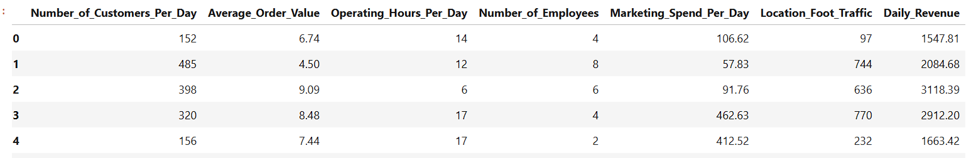
Data Import and Library Setup
Import necessary libraries:
Load data from a CSV file:
import pandas as pd
import numpy as np
import seaborn as sns
import matplotlib.pyplot as plt
df = pd.read_csv(r'C:\Downloads\coffee_shop_revenue.csv')

Slide 3
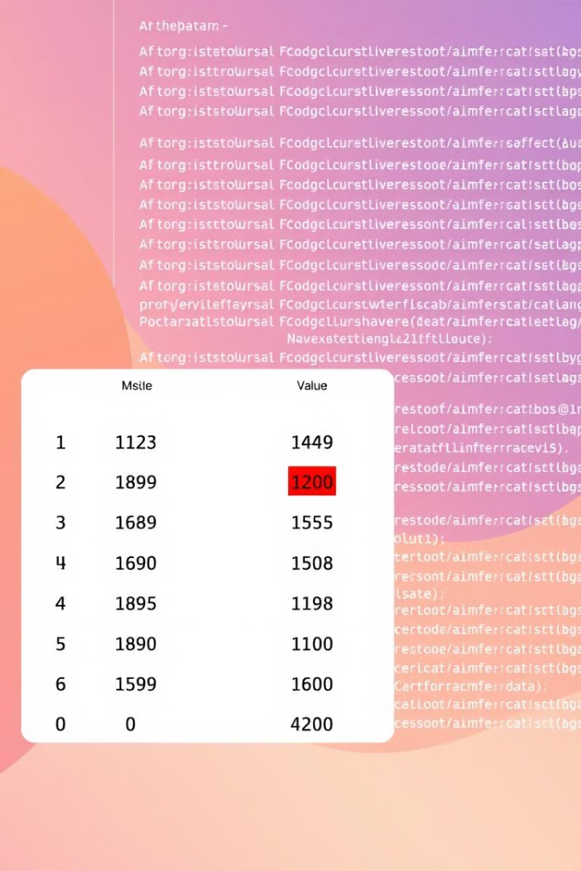
Handling Missing and Duplicate Data
Identify missing values:
data.isnull().sum()
Impute missing values:
data['column'].fillna(data['column'].mean(), inplace=True)
Identify duplicates:
data.duplicated().sum()
Remove duplicates:
data.drop_duplicates(inplace=True)

Slide 4
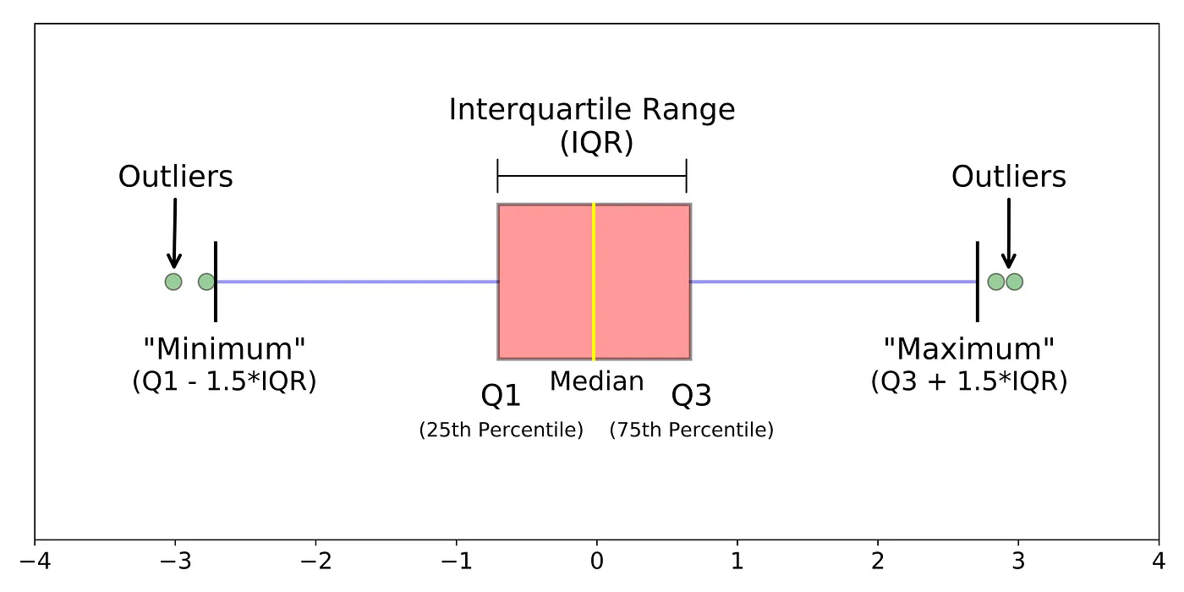


Outlier Detection and Treatment Strategies
Box plots can visually identify outliers.
Remove outliers using IQR method or other suitable techniques.

Slide 5
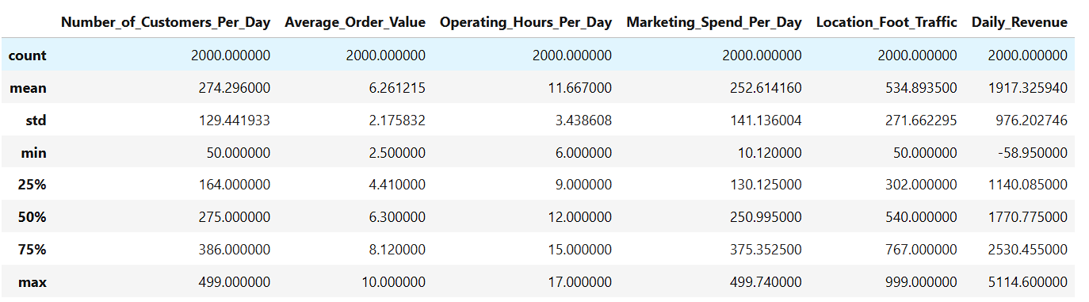
HOW TO FIND OUTLIER PRESENT OR NOT
In the dataset the large difference between the minimum (-58.95), mean (1917.33), and maximum (5114.60) values in the Daily_Revenue column suggests potential outliers.

Slide 6
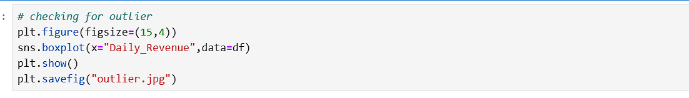
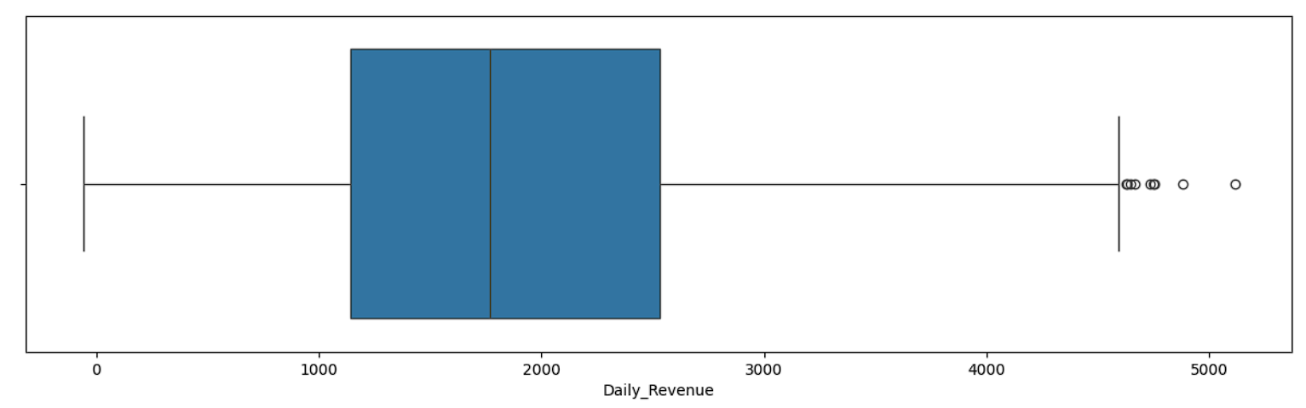

Slide 7
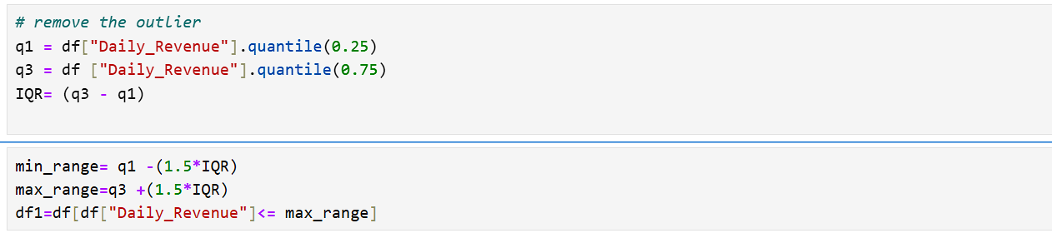
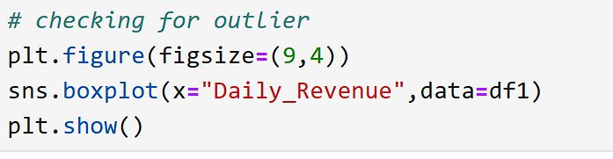
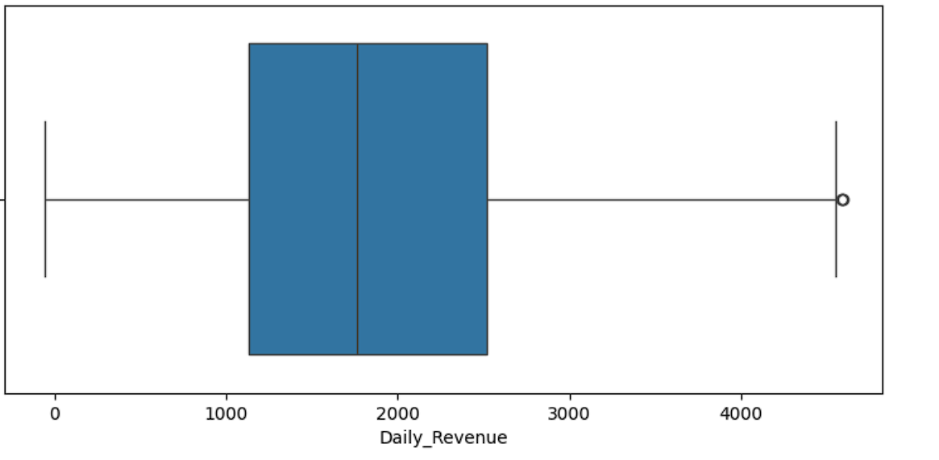
Remove the outlier by the INTER QUARTILE RANGE (IQR) method
Checking the outlier present or not

Slide 8
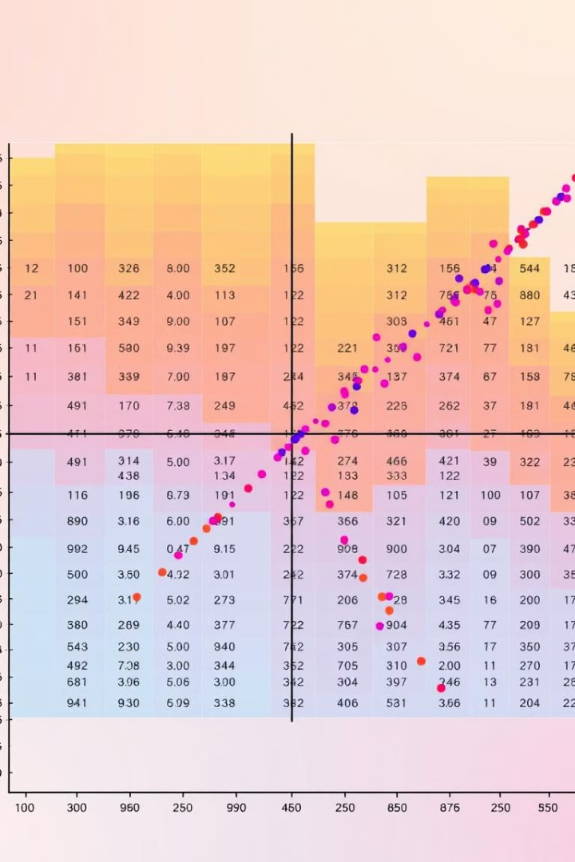
Feature Selection: Analyzing Input-Output Relationships
1
Examine correlation between features and target variable.
2
Use feature selection methods such as SelectKBest or recursive feature elimination.
3
Remove irrelevant features to improve model accuracy.

Slide 9
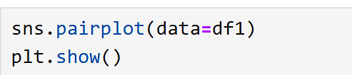
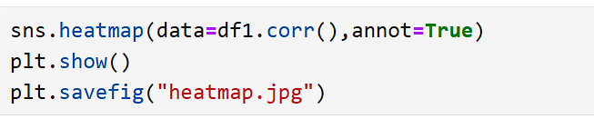
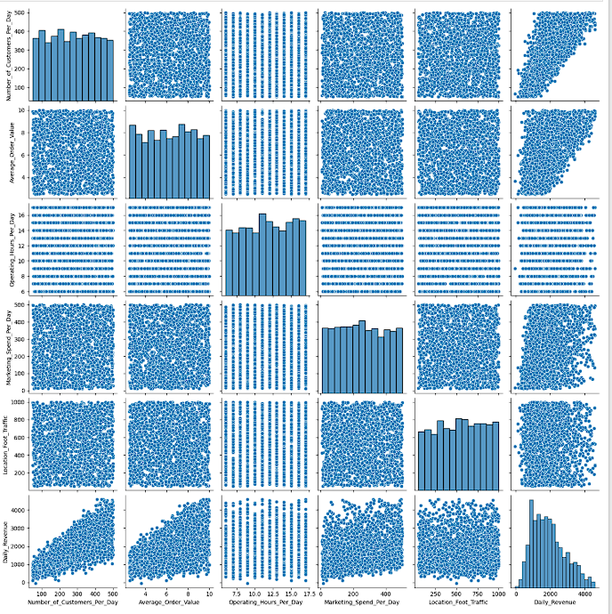
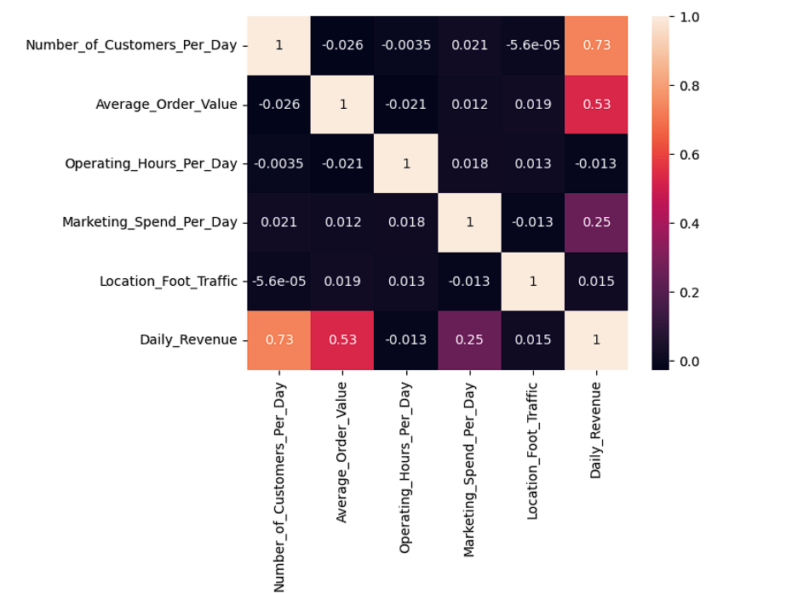
Find relationship between output and input features
, from the pair plot, we can see that:
Number_of_Customers_Per_Day vs. Daily_Revenue shows a strong positive linear relationship.
Average_Order_Value vs. Daily_Revenue also exhibits a linear trend.
Marketing_Spend_Per_Day vs. Daily_Revenue has a somewhat positive linear correlation.

Slide 10
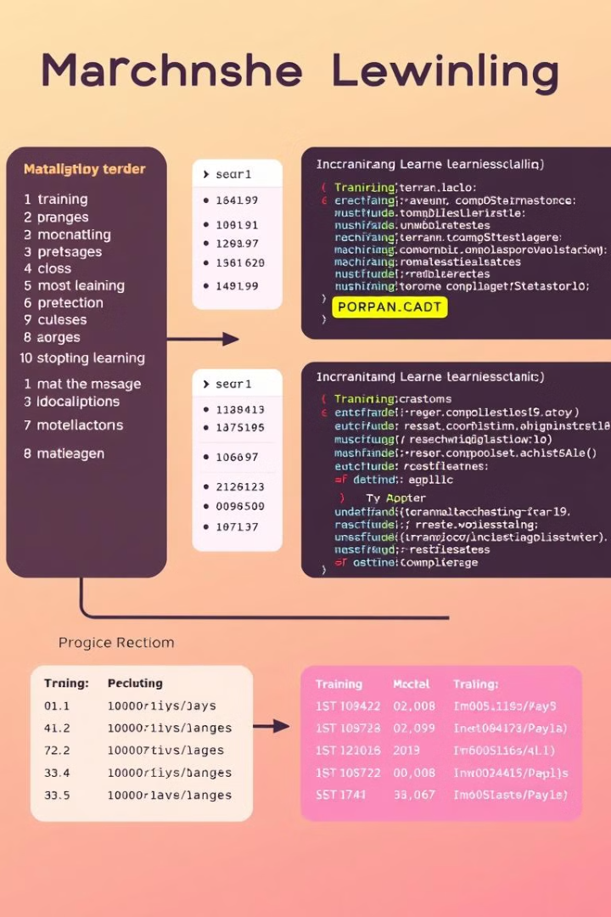



Machine Learning Model Deployment and Prediction
Split data into training and testing sets.
Train a linear regression model on the training data.
Make predictions on the testing data.

Slide 11
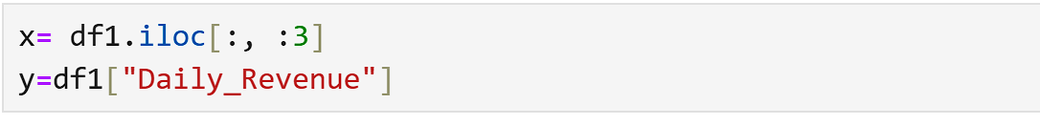
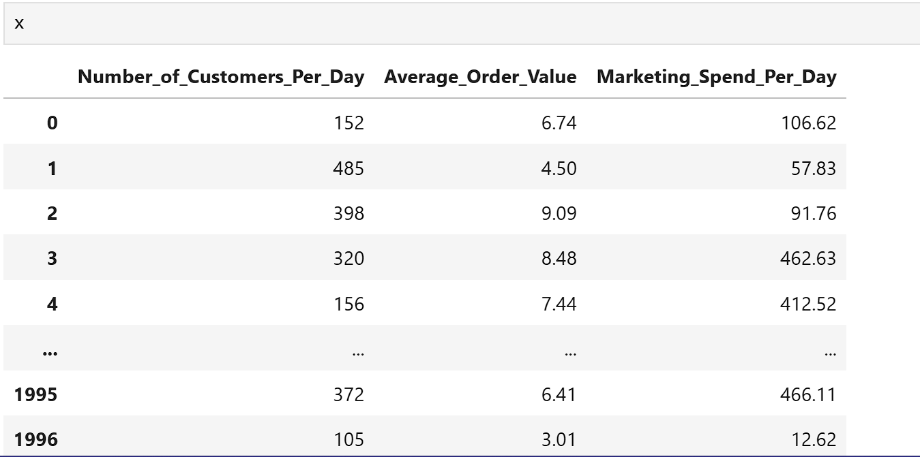
Separate the all-input features and output

Slide 12
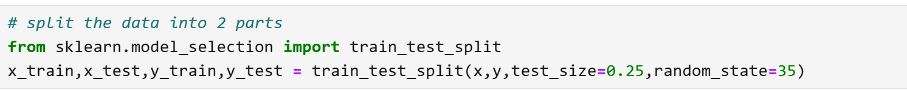
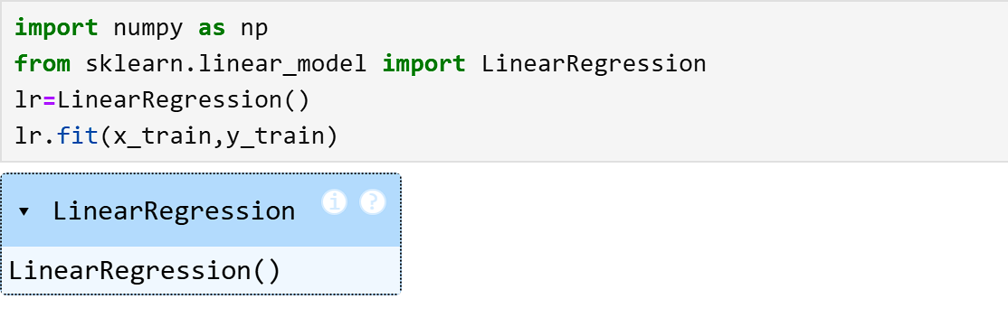
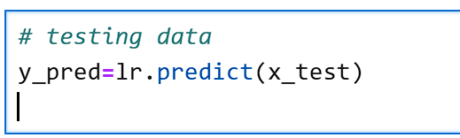
Split the the data into two parts and Deployment Machine Learning Model

Slide 13
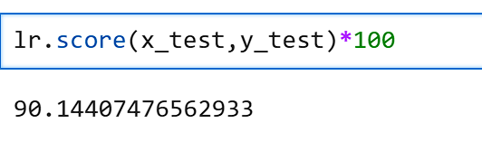
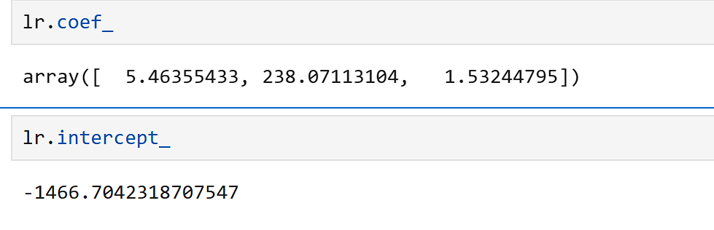
Model Evaluation: Accuracy, Coefficients, and Intercept
90.144
5.463, 238.071, 1.532
-1466.704
Accuracy
Coefficients
Intercept
Evaluate model performance using metrics like R-squared or mean squared error.
Interpret coefficients to understand the impact of each feature on revenue.
The intercept represents the baseline revenue when all features are zero.

Slide 14
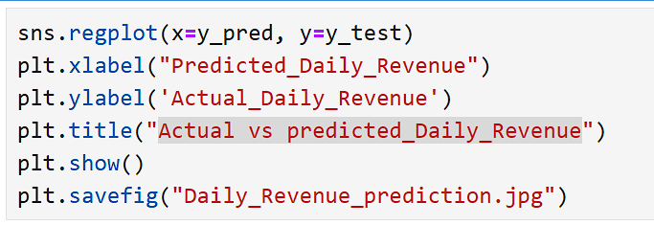
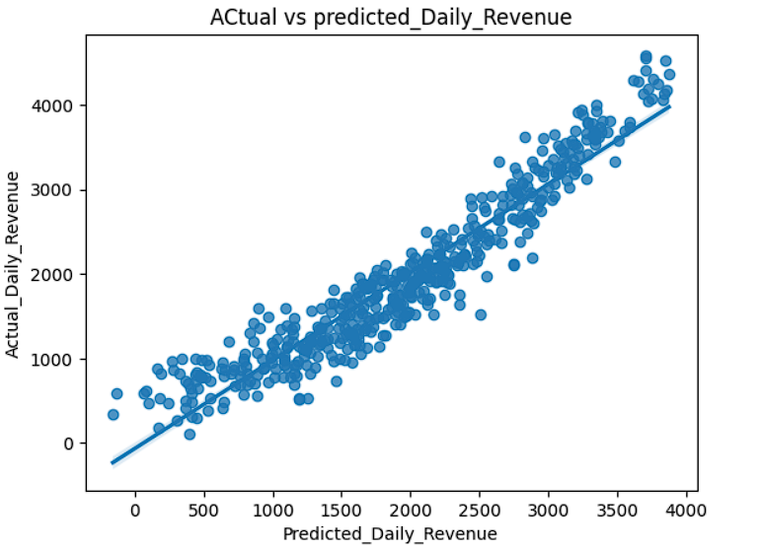
Actual vs predicted_Daily_Revenue

Slide 15

Conclusion: Key Findings and Future Improvements
The model provides a valuable tool for predicting coffee shop revenue, helping to inform decision-making and optimize operations. Future improvements include exploring more advanced models, incorporating seasonal trends, and expanding the dataset for better accuracy.
GITHUB LINK - CLICK HERE

